Slide 1

Query personalisation and recommendation in data warehouse: an overview
Patrick Marcel, Université François Rabelais Tours
Laboratoire d’Informatique

Slide 2
Outline
Introduction
Query personalisation
  Basics on orders and preferences
  Overview of existing approaches in relational databases
  Existing approaches in multidimensional databases
Query recommendation
  Basics on recommender systems
  Overview of existing approaches in relational databases
  Existing approaches in multidimensional databases
Conclusion
Bibliography

Slide 3
Introduction

Slide 4
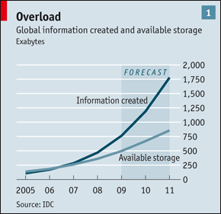
Why personalisation or recommendation?
[…] mankind created 150 exabytes (billion gigabytes) of data in 2005. This year [2010], it will create 1,200 exabytes.
    The Economist, The Data Deluge, Feb 25th 2010
Databases should be more user-friendly [Jagadish & al., 2007]
  Instances are huge, schemas are complex
  The user may not know SQL, the schema, the values

Slide 5






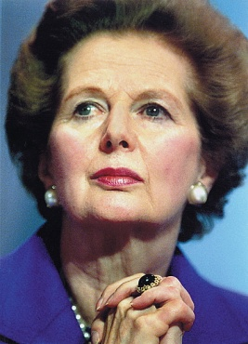
Why personalisation?
“iron maiden?”

Slide 6
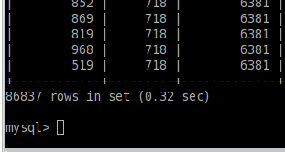

Why personalisation in database?
Given a database query q
  Am I always happy with the result?
    Too many answers
      How to focus on the most relevant?
    Too few answers
      How to soften hard constraints?
Adding preferences to queries
  If too many answers
    Rank them to focus on the preferred ones
  If too few answers
    Consider selections as preferences, not constraints

Slide 7

Why recommendation?
“Books by T. Pratchett?”
“Consider also books
by D. Adams”
Same style
Same price
Popular
New edition
…

Slide 8
Why recommendation in databases?
Sales of cheese for 2010 by countries
Sales | 2010
France | 90
Italy | 70
Spain | 40
UK | 25
Sales of cheese for 2009 by countries?
Sales of cheese by French cities?
Sales of cheese by years?

Slide 9
Scope
Personalisation
  A process that, given a database query q and some profile, computes another query q’ ⊂ q that has an added value for the user
Recommendation
  A process that, given a database query q and some profile, computes another query q’ ⊄ q that has an added value for the user
What is outside the scope
  Other forms of query transformation (relaxation, completion, etc.)
  Other data types (XML, etc.)
  Implementation and evaluation issues

Slide 10
Categorisation: [Golfarelli & Rizzi, 2010]
Formulation effort:
  How profile is specified
Prescriptiveness:
  How profile is incorporated to the query
Proactiveness:
  How profile affects query evaluation
Expressiveness:
  How complex profile is

Slide 11
Formulation effort
You may prefer…
Formulation effort:
  Profile elements manually specified for each query, or
  Profile inferred from the context and/or past actions.

Slide 12
Prescriptiveness
Go there !
Consider this first…
Prescriptiveness:
  Profile elements added as hard constraints to a query, or
  Tuples that satisfy as much profile as possible are returned even if no tuples satisfies all the profile.

Slide 13

Proactiveness (1)
User profile
Personalize and execute or execute and personalize
Present the result
User query
Proactiveness:
  Change the current query before execution or post process its results, or
  Suggest new queries without executing them.

Slide 14
Proactiveness (2)
User profile
User query
Suggest
Proactiveness:
  Change the current query before execution or post process its results, or
  Suggest new queries without executing them.

Slide 15
Expressiveness
I prefer movies directed by David Lynch
I prefer movies directed by David Lynch
But I also prefer short movies
I like Julia Roberts more than Nicole Kidman
Well it depends if it is a drama or a comedy
Length is more important than the director
Except if it is a comedy
…

Slide 16
Basics on preferences

Slide 17
Example
Movies | Author | Genre | Price | Duration
t1 | Cohen | Comedy | 5 | 90
t2 | Cohen | Comedy | 6 | 100
t3 | Cohen | Comedy | 7 | 80
t4 | Allen | Drama | 7 | 120
t5 | Lynch | Drama | 5 | 150
“I prefer Lynch movies over Allen’s and Allen movies over Cohen’s”
  Then t5 preferred to t4 and t4 preferred to t1, t2, t3
  Nothing is said e.g., for t1 and t2, neither for t1 and t3

Slide 18
Example of representation
t5 (Lycnh,Drama,5,150)
Reads “I prefer”
t4 (Allen,Drama,7,120)
t1 (Cohen,Comedy,5,90)
t2 (Cohen,Comedy,6,100)
t3 (Cohen,Comedy,7,80)
“I prefer Lynch movies over Allen’s and Allen movies over Cohen’s”
  t5 > t4
  t4 > t1, t4 > t2, t4 > t3
  Prefers(t5,t4)
  Prefers(t4,t1), Prefers(t4,t2), Prefers(t4,t3)

Slide 19
Another formulation
t5 (Lycnh,Drama,5,150)
t4 (Allen,Drama,7,120)
t1 (Cohen,Comedy,5,90)
t2 (Cohen,Comedy,6,100)
t3 (Cohen,Comedy,7,80)
“I like Lynch: score=0.9”
“I like Allen: score=0.8”
“I like Cohen: score=0.5”

Slide 20
Qualitative versus quantitative
Qualitative Approaches
  Relative preferences of the form I like A better than B
  Based on Partial ordering
    I like A better than B iff (A > B) where “>” is a partial ordering
Quantitative Approaches
  Absolute preferences of the form I (do not) like A to a specific degree
  Based on Scoring / Utility Functions
    I like A better than B iff u(A) > u(B) where “u” is a scoring function
However, not every intuitively plausible preference relation can be captured by scoring functions
  But scoring functions can express the “intensity” of the preference

Slide 21
Preferences are usually SPO
Strict Partial Order (SPO)
  A binary relation “>” over a set O which is
    Irreflexive: ¬(a > a)
    Asymmetric: If (a ≠ b) and (a > b) then ¬(b > a)
    Transitive: If (a > b) and (b > c) then (a > c)
Preferences are usually assumed to be SPO
  I like “a” better than “b” if (a > b)
  I consider a and b indifferent (a ~ b) if ¬(a > b) and ¬(b > a)

Slide 22
Preference composition
Movies | Author | Genre | Price | Duration
t1 | Cohen | Comedy | 5 | 90
t2 | Cohen | Comedy | 6 | 100
t3 | Cohen | Comedy | 7 | 80
t4 | Allen | Drama | 7 | 120
t5 | Lynch | Drama | 5 | 150
“I prefer Lynch’s over Allen’s and Allen’s over Cohen’s”
“I also prefer shorter movies”

Slide 23
Example of quantitative composition
“I prefer Lynch’s over Allen’s and Allen’s over Cohen’s”
  “I like Lynch with score_{P1}=0.9”
  “I like Allen with score_{P1}=0.8”
  “I like Cohen with score_{P1}=0.5”
“I also prefer shorter movies”
  “I like (duration=80) with score_{P2}=1”, “I like (duration=90) with score_{P2}=0.9”, …, “I like (duration=150) with score_{P2}=0.6”
Combination can be with weighted summation
  Score_{f(P1,P2)}(t_{i})=x score_{P1}(t_{i}) + (1-x) score_{P2}(t_{i})

Slide 24
Examples of qualitative composition
“I prefer Lynch’s over Allen’s and Allen’s over Cohen’s”
“I also prefer shorter movies”
P1
t5 (Lycnh,Drama,5,150)
P2
t3 (Cohen,Comedy,7,80)
t1 (Cohen,Comedy,5,90)
t4 (Allen,Drama,7,120)
t2 (Cohen,Comedy,6,100)
t1 (Cohen,comedy,5,90)
t3 (Cohen,comedy,7,80)
t2 (Cohen,comedy,6,100)
t4 (Allen,Drama,7,120)
t5 (Lycnh,Drama,5,150)

Slide 25
    Intersection P1 ∩ P2
    (t >∩ t’) if (t >_{P1} t’) and (t >_{P2} t’)
“I prefer Lynch’s over Allen’s and Allen’s over Cohen’s”
“I also prefer shorter movies”
A partial order where everything is preferred
t3 (Cohen,Comedy,7,80)
t1 (Cohen,Comedy,5,90)
t2 (Cohen,Comedy,6,100)
t4 (Allen,Drama,7,120)
t5 (Lycnh,Drama,5,150)

Slide 26
Union P1 ∪ P2
(t >∪ t’) if (t >_{P1} t’) or (t >_{P2} t’)
“I prefer Lynch’s over Allen’s and Allen’s over Cohen’s”
“I also prefer shorter movies”
t5 (Lycnh,Drama,5,150)
Violates irreflexivity and asymmetry!
t4 (Allen,Drama,7,120)
t3 (Cohen,comedy,7,80)
t1 (Cohen,comedy,5,90)
t2 (Cohen,comedy,6,100)

Slide 27
    Prioritization P1 ▹ P2
    (t >▹ t’) if (t >_{P1} t’) or (¬(t’ >_{P1} t) and (t >_{P2} t’) )
“I prefer Lynch’s over Allen’s and Allen’s over Cohen’s”
“I also prefer shorter movies”
t5 (Lycnh,Drama,5,150)
A total order
t4 (Allen,Drama,7,120)
t3 (Cohen,Comedy,7,80)
t1 (Cohen,Comedy,5,90)
t2 (Cohen,Comedy,6,100)

Slide 28
  Pareto P1 ⊗ P2
  (t >⊗ t’) if ((t >_{P1} t’) and (t >_{P2} t’ or t ~_{P2} t’)) or ((t >_{P2} t’) and (t >_{P1} t’ or t ~_{P1} t’))
“I prefer Lynch’s over Allen’s and Allen’s over Cohen’s”
“I also prefer shorter movies”
t5 (Lycnh,Drama,5,150)
t3 (Cohen,Comedy,7,80)
t1 (Cohen,Comedy,5,90)
t4 (Allen,Drama,7,120)
t2 (Cohen,Comedy,6,100)

Slide 29
Existing approaches
In relational databases

Slide 30
Two approaches
Preference operators
  Use explicit preference operator(s) in queries
    Winnow [Chomicki, 2003]
    Preference SQL [Kießling, 2002]
      High formulation effort , not prescriptive, not proactive, high expressiveness
    Skyline [Börzsönyi et al., 2001]
    Top-k [Fagin et al., 2001]
Query personalisation
  Rewrite regular queries with elements of a profile
    [Koutrika & Ioannidis, 2004]
      Low formulation effort, prescriptive, not proactive, low expressiveness

Slide 31
Winnow / BMO (Best-Matches-Only)
Given
  A relation r of schema sch(r)
  A preference C over sch(r) defining a preference relation >_{C}
The winnow operator, denoted w_{C}, is defined by:
  w_{C}(r) = { t ∈ r | (∄ t’ ∈ r)(t’ >_{C} t) }

Slide 32
Example
Movies | Author | Genre | Price | Duration
t1 | Cohen | Comedy | 5 | 90
t2 | Cohen | Comedy | 6 | 100
t3 | Cohen | Comedy | 7 | 80
t4 | Allen | Drama | 7 | 120
t5 | Lynch | Drama | 5 | 150
Preference C is
  “I prefer drama”
Who are the authors of my most preferred affordable movies?
    Π_{Author}(w_{C}(σ_{Price<7}(Movies)))

Slide 33
Using Winnow to order results
Let q be a query and C be a preference
  w_{C} (q) gives the most preferred tuples of q
  w_{C} (q- w_{C} (q)) gives the second most preferred tuples of q
  Etc.
The answer to q can be partitioned according to C
  q= w_{C} (q) ∪ w_{C} (q- w_{C} (q)) ∪ …

Slide 34
Example
t5 (Lycnh,Drama,5,150)
t4 (Allen,Drama,7,120)
t1 (Cohen,Comedy,5,90)
t2 (Cohen,Comedy,6,100)
t3 (Cohen,Comedy,7,80)
Model C is
  “I prefer drama”
What are my most preferred affordable movies?
    w_{C}(σ_{Price<7}(Movies))
Answer is
  First: t5
  Then: t1,t2

Slide 35
Preference SQL [Kießling, 2002]
Built-in Preference Constructors
  SELECT * FROM Movies
  PREFERING HIGHEST(Duration)
    (x >_{HIGHEST} y) if x > y
  SELECT * FROM Movies
  PREFERING genre IN ( ‘Drama’,’Thriller’ )
    (x >_{IN (‘Drama’,’Thriller’)} y) if x ∈{‘Drama’,’Thriller’} and
    y ∉{‘Drama’,’Thriller’ }
  SELECT * FROM Movies
  PREFERING Duration AROUND 90
    (x >_{AROUND(90)} y) if |x – 90| < |y – 90|

Slide 36
Preference SQL
How to assemble Complex Preferences
  With Pareto Composition
    SELECT * FROM Movies
    PREFERING HIGHEST(Duration)
    AND Genre IN (‘Drama’,’Thriller’)
  With Prioritized Composition
    SELECT * FROM Movies
    PREFERING HIGHEST(Duration)
    CASCADE Genre IN (‘Drama’,’Thriller’)

Slide 37
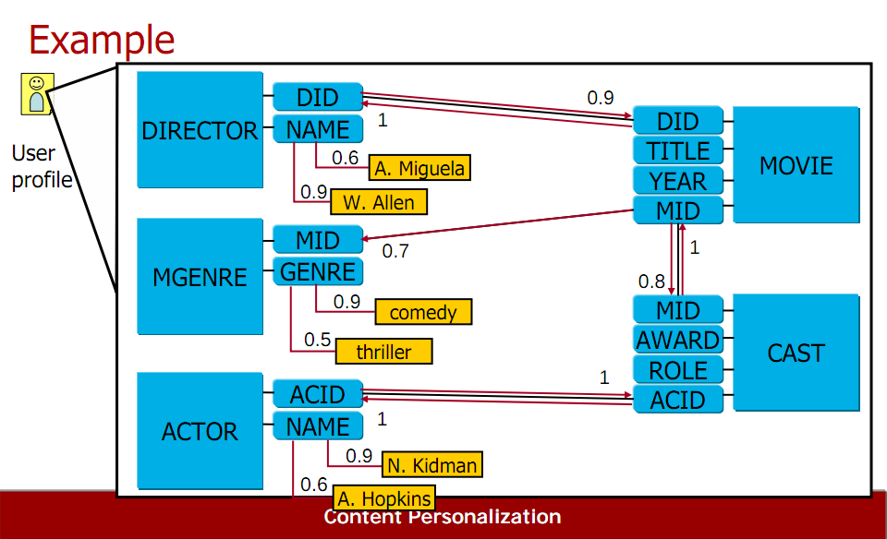
Example [Koutrika & Ioannidis, 2005]

Slide 38
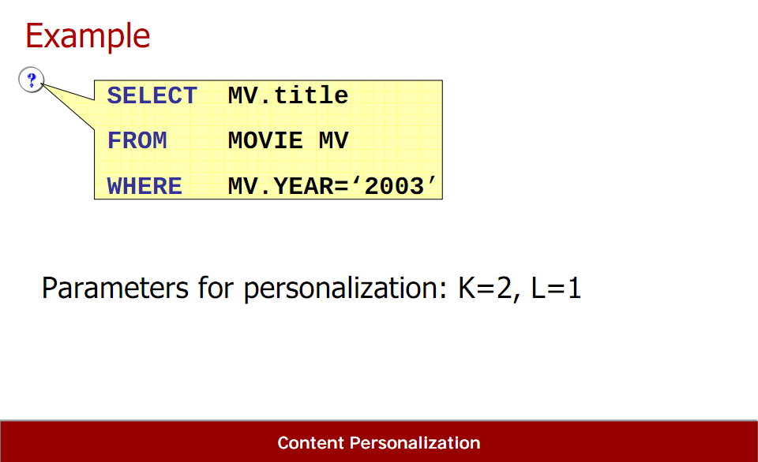
User query
Results should satisfy at least L of the K preferences

Slide 39
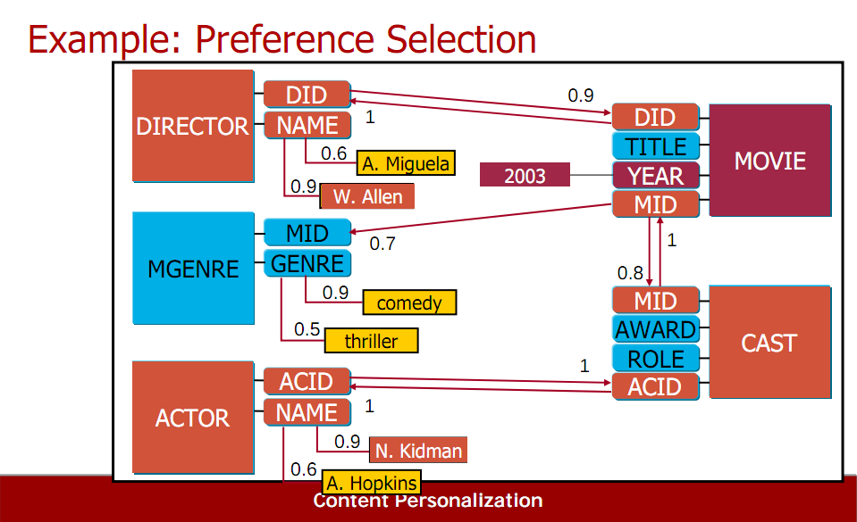
Preference selection

Slide 40
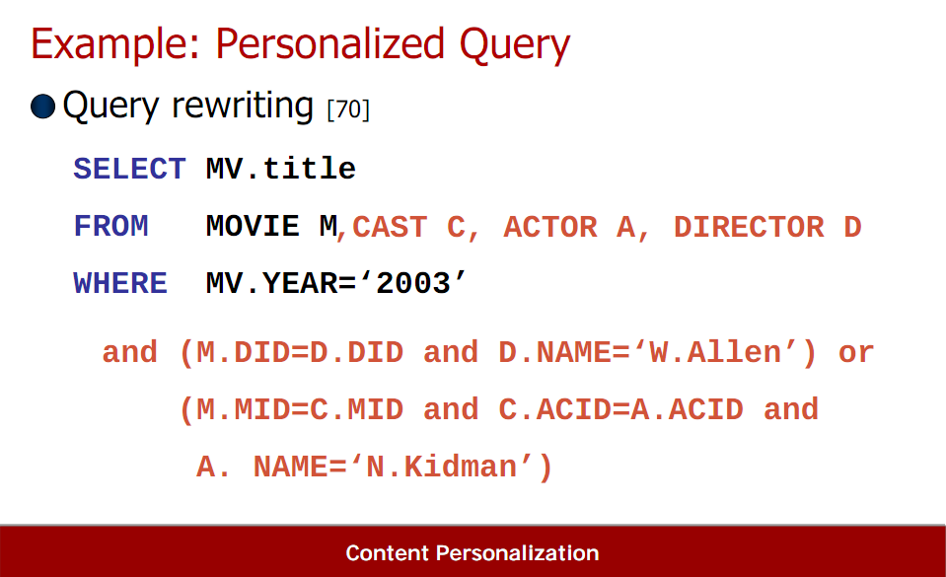
Query extension

Slide 41
Existing approaches
In multidimensional databases

Slide 42
Peculiarities of data warehouses
Data warehouses are particular databases
  Read mostly instance, with an inflationist evolution
  Schema inducing a particular topology
  Shared in a multi-user environment
Analytical queries over data warehouses
  Expressed in a dedicated query language (MDX)
  May produce large results, visualised as crosstabs
  Are grouped into sessions having an analytical goal
  Are written based on:
    Past results of the session
    User expectations

Slide 43
Two existing approaches
[Bellatreche & al. 2005]
  Inspired by Koutrika & Ioannidis
  Query personalisation for computing preferred visualisations
  Low formulation effort, prescriptive, not proactive, low expressiveness
[Golfarelli & Rizzi, 2009]
  Inspired by Kießling
  Preference operators adapted to the multidimensional context
  High formulation effort, not prescriptive, not proactive, high expressiveness

Slide 44
[Bellatreche et al. 2005]
SELECT CROSSJOIN({City.Tours, City.Orleans},
{Category.Members}) ON ROWS
{2003, 2004, 2005, 2006} ON COLUMNS
FROM SalesCube
WHERE (Measures.quantity)
Visualization depends on the user's profile

Slide 45

Problem formulation
User profile P
Execute the personalized query
Present the visualisation
Personalize q
User query q
Visualisation constraint v
compute q’= max_{<P} {q’’ ⊆ q | v(q’’) = true}

Slide 46
Example of preferred query
 |  | 2005
Tours | Food
 | Drink
 |  | Drink
Tours | 2006
<
SELECT CROSSJOIN({City.Tours},
{Category.Food,Category.Drink}) ON ROWS
{Year.2005} ON COLUMNS
FROM SalesCube
WHERE (Measures.quantity)
SELECT CROSSJOIN({City.Tours},
{Year.2006}) ON ROWS
{Category.Drink} ON COLUMNS
FROM SalesCube
WHERE (Measures.quantity)
Since the user profile contains
Location < Product, Product < Time
2005 < 2006, Food < Drink
Indeed:
(2005,Food,Tours,quantity) < (2006,Drink,Tours,quantity)
(2005,Drink,Tours,quantity) < (2006,Drink,Tours, quantity)

Slide 47
Principle
Context
  Dimension tables in main memory
  No access to the fact table
Algorithm
  Compute sets of positions in the resulting crosstab
    Largest possible
    Visualizable w.r.t. the visualization constraint
    Corresponding to the preferred facts
  Compute the structures of the crosstabs

Slide 48
Example of personalization (1)
The query:
        SELECT CROSSJOIN({City.Tours, City.Orleans},
        {Category.Members}) ON ROWS
        {2003, 2004, 2005, 2006} ON COLUMNS
        FROM SalesCube
        WHERE (Measures.quantity)
Preferences:
        Time < Location and Product < Location
        2002 < 2003 < 2004 < 2005 < 2006
        Electronics < shoes < cloth < food < drink
        Quantity < price
Constraint: 2 axes, no more than 4 positions on each axis

Slide 49
Example of personalization (2)
Step 1
The most preferred references

Slide 50
Example of personalization (3)
Step 2
The second most preferred
references

Slide 51
Example of personalization (4)
Step 3: the next most preferred references
But the selected references have to satisfy the visualization constraint

Slide 52
Example of personalization (5)
Finally, one of the constructed query is
SELECT CROSSJOIN({City.Tours, City.Orleans},
{Category.Food, Category.drink}) ON ROWS
{2003, 2004, 2005, 2006} ON COLUMNS
FROM SalesCube
WHERE (Measures.quantity)

Slide 53
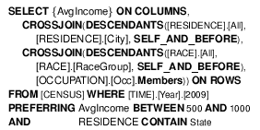
[Golfarelli & Rizzi 2009,2011]
Adaptation of preference constructors to multidimensional context
  POS operators extends to hierarchies
  Preferences can be expressed over attributes (levels in hierarchies) and thus over cuboids
  Preferences can be expressed over numerical values (measures)
Composition: Prioritization and Pareto

Slide 54
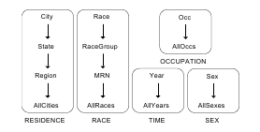
Example of constructors
POS(City,Paris)
  (Paris,all,2010,F,all) > (Barcelona,all,all,all,all)
  (France,all,2009,all,all) > (Barcelona,all,2010,all,all)
CONTAIN(RESIDENCE,City)
  (Paris,all,2010,F,all) > (France,all,2009,all,all)

Slide 55
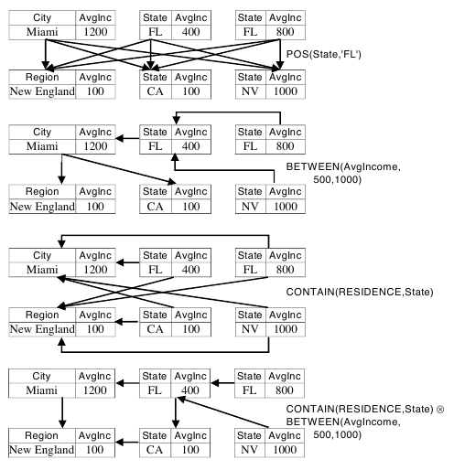
Example of dominations

Slide 56
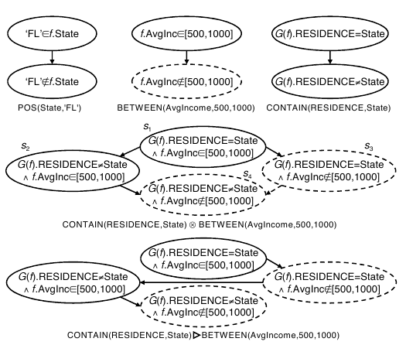
Examples: wBT graph

Slide 57
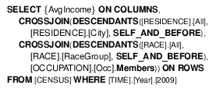
Improving proactiveness
[Aligon & al, 2011]
User’s log of past queries
User’s current query
Execute the personalized query
Extract association rules
Extract relevant preferences
AvgIncome → RESIDENCE CONTAIN State
…

Slide 58
Query recommendation

Slide 59
Basics of recommender systems

Slide 60
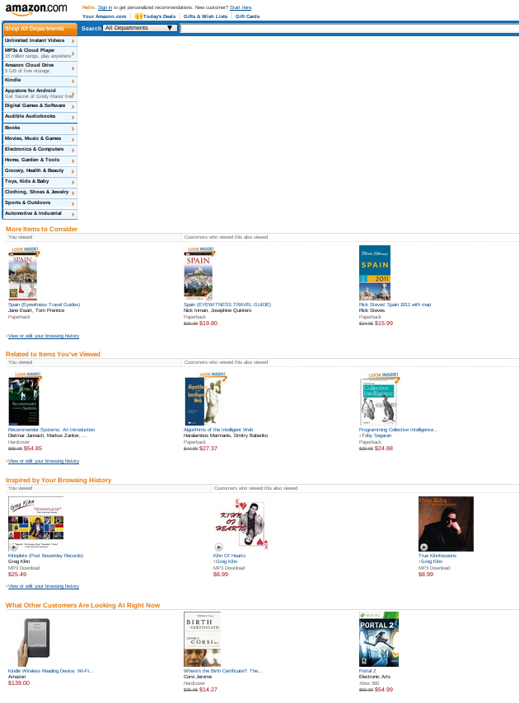
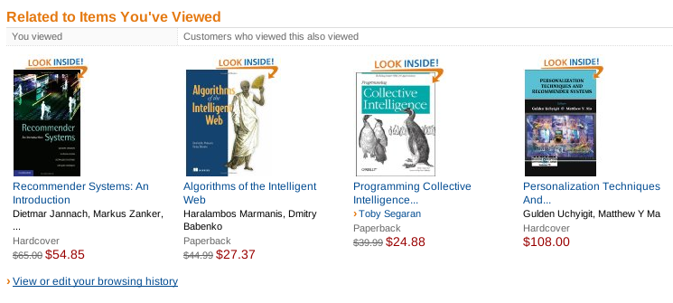
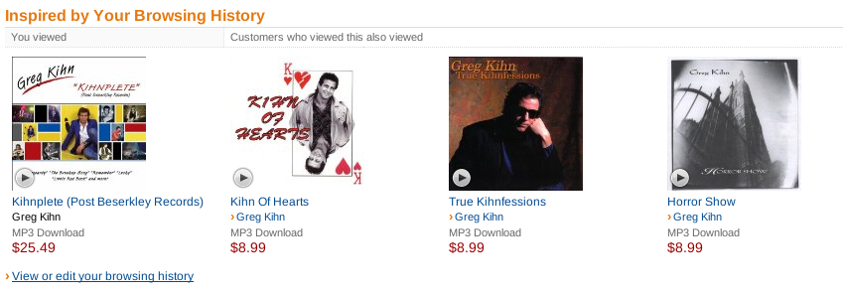
Recommender systems
Amazon: 35% sales from recommendations

Slide 61
The basic model
interest | Item 1 | Item 2 | Item 3 | … | Item m
User 1 | 0.3 |  | 0.9 | … | 0.7
User 2 |  | 0.4 | 0.8 | … | 0.6
User 3
… | … | … | … | … | …
User n | 0.9 | 0.5 |  | … | 0.2
A matrix customers * items recording the interests
Recommend the items having highest ratings
But
  Ratings are hard to find
  Matrix is huge and sparse
  Everyone is a bit eccentric [WSDM 2010]

Slide 62
Three classical approaches
Content-based
  Recommend items similar to those highly rated
Collaborative
  Recommend items highly rated by similar users
Hybrid
  Combine content-based and collaborative
A lot of works in the areas of e-commerce, Web, IR, …
  See e.g., “Recommender systems handbook”, Springer, 2011

Slide 63
Example of content-based recommendations: build item profile
 | Donuts | Duff | Apple | Tofu | Water | Bud | Ribs
Homer | 0.9 | 0.8 |  |  |  | 0.7
Marge |  |  | 0.8 |  | 0.6
Bart | 0.7 | 0.6 | 0.1 |  |  |  | 0.8
Lisa | 0.2 |  |  | 0.8 | 0.6
Maggie | 0.6 |  |  | 0.5 | 0.6
Features: contains sugar, ok for diet
Profile of Donuts: (0.9,0)
Profile of Duff: (0.6,0.1)
Profile of Apple: (0.4,0.6)
Profile of Tofu: (0,0.9)
…

Slide 64
Example of content-based recommendations: build user profile
 | Donuts | Duff | Apple | Tofu | Water | Bud | Ribs
Homer | 0.9 | 0.8 |  |  |  | 0.7
Marge |  |  | 0.8 |  | 0.6
Bart | 0.7 | 0.6 | 0.1 |  |  |  | 0.8
Lisa | 0.2 |  |  | 0.8 | 0.6
Maggie | 0.6 |  |  | 0.5 | 0.6
Features: contains sugar, ok for diet
Profile of Homer: (0.9*(0.9,0) + 0.8*(0.6,0.1) …)/3
  = (0.8,0.1)
Profile of Lisa: (0.3,0.8)
…

Slide 65
Example of content-based recommendations: compare profiles
 | Donuts | Duff | Apple | Tofu | Water | Bud | Ribs
Homer | 0.9 | 0.8 |  |  |  | 0.7
Marge |  |  | 0.8 |  | 0.6
Bart | 0.7 | 0.6 | 0.1 |  |  |  | 0.8
Lisa | 0.2 |  |  | 0.8 | 0.6
Maggie | 0.6 |  |  | 0.5 | 0.6
Compare Homer profile to Apple profile:
  cosine((0.8,0.1),(0.4,0.6)) =0.33
Compare Homer profile to Tofu profile
  cosine((0.8,0.1),(0,0.9)) =0.1
…
In the end, recommend Ribs to Homer, Apple to Lisa

Slide 66
Example of user-user collaborative: find similar users
 | Donuts | Duff | Apple | Tofu | Water | Bud | Ribs
Homer | 0.9 | 0.8 |  |  |  | 0.7
Marge |  |  | 0.8 |  | 0.6
Bart | 0.7 | 0.6 | 0.1 |  |  |  | 0.8
Lisa | 0.2 |  |  | 0.8 | 0.6
Maggie | 0.6 |  |  | 0.5 | 0.6
Find similar users
  Compare Homer and Marge
    Cosine((0.9,0.8,0,…),(0,0,0.8,…))
  Compare Homer and Bart
    Cosine((0.9,0.8,0,…),(0.7,0.6,0.1,…))
  …

Slide 67
Example of user-user collaborative: compute score
 | Donuts | Duff | Apple | Tofu | Water | Bud | Ribs
Homer | 0.9 | 0.8 |  |  |  | 0.7 | *
Marge |  |  | 0.8 |  | 0.6
Bart | 0.7 | 0.6 | 0.1 |  |  |  | 0.8
Lisa | 0.2 |  |  | 0.8 | 0.6
Maggie | 0.6 |  |  | 0.5 | 0.6
Recommend items highly rated by similar users
  Rating weighted with similarity score
    Cosine(Homer,Bart)

Slide 68
Existing approaches
In relational databases

Slide 69
How to recommend? [PersDB@VLDB 2009]
Use current state of the database
  Find correlated attributes, most frequent values, etc.
Use history (query log)
  Compute similarities among users, similarities among queries
Use external data
  E.g., wikipedia, etc.

Slide 70
YMAL [PersDB@VLDB 2009]
Example
Local analysis
  Select title, genre from Movies where actor=‘C. Lee’
  The result has a lot of genre=‘fantastic’
  Recommend:
    Select title, genre from Movies where genre=‘fantastic’
Global analysis
  Value ‘Allen’ of attribute Director is correlated with value ‘Comedy’ of attribute Genre
  Select * from Movies where director=‘Allen’
  Recommend:
    Select * from Movies where genre=‘Comedy’

Slide 71
QueRIE [SSDBM 2009], [PVLDB 2010]
 | Tuple 1 | Tuple 2 | Tuple 3 | … | Tuple n
Session 1 | 1 | 0 | 0 |  | 0
Session 2 | 0 | 1 | 1 |  | 1
Session 3 | 0 | 0 | 0 |  | 1
…
Session m | 1 | 1 | 0 |  | 0
Current session S_{c}=(1,…,0)
Find session S most similar to S_{c} using cosine
Recommend the query of S that is the most similar to S_{c}

Slide 72
Existing approaches
In multidimensional databases

Slide 73
Why recommendation?
Sales of cheese for 2010 by countries
Sales | 2010
France | 90
Italy | 70
Spain | 40
UK | 25
Sales of cheese for 2009 by countries?
Sales of cheese by French cities?
Sales of cheese by years?

Slide 74
Profile?
I prefer to compare with former sales
Sales of cheese for 2010 by countries
Sales | 2010
France | 90
Italy | 70
Spain | 40
UK | 25
Sales of cheese for 2009 by countries?

Slide 75
Expectations?
I expect sales to be uniformly distributed
Sales of cheese for 2010 by countries
Sales | 2010
France | 90
Italy | 70
Spain | 40
UK | 25
Sales of cheese by French cities

Slide 76


Others?
Sales of cheese for 2010 by countries
Sales | 2010
France | 90
Italy | 70
Spain | 40
UK | 25
Sales of cheese by years?
Sales of cheese by years?
Sales of cheese by years?
Sales of cheese by years

Slide 77
Four different approaches
Content-based methods based on user preferences
  Current state, with external data
Content-based methods based on expectations
  Current state
Collaborative methods based on a query log
  History-based
Collaborative methods based on log and expectations
  Current state and history-based
All approaches:
  Low formulation effort, prescriptive, proactive, low expressiveness

Slide 78
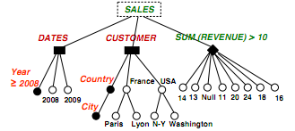
1. Preference-based recommendations
[DaWaK 2009]
If query concerns 2009, score of Barcelona is 0.9
If query concerns N-Y, score of SUM(REVENUE)>50 is 0.8
If query concerns 2009, score of Madrid is 0.4
If query concerns 2010, score of Paris is 0.3
…
The preferences
The query
Recommend:
Add Barcelona to the list of cities
Change SUM(REVENUE)>10 by SUM(REVENUE)>50

Slide 79
2. Expectation-based recommendations
Discovery driven analysis [VLDB 2000]
Sales | Quarter 1
Europe | 100
The current query result
Not surprising, do not recommend it
Surprising, recommend it
Sales | Quarter 1
France | 25
Italy | 25
Spain | 25
UK | 25
Sales | Jan | Feb | Mar
Europe | 80 | 10 | 10

Slide 80
2. Expectation-based recommendations
Discovery driven analysis [DaWaK 2008]
Sales | All, All
France | 10
UK | 20
The current query result
Not surprising, do not recommend it
Surprising, recommend it
Sales | Drink | Food
France | 7 | 3
UK | 4 | 16
Sales | 2009 | 2010
France | 8 | 2
UK | 16 | 4

Slide 81
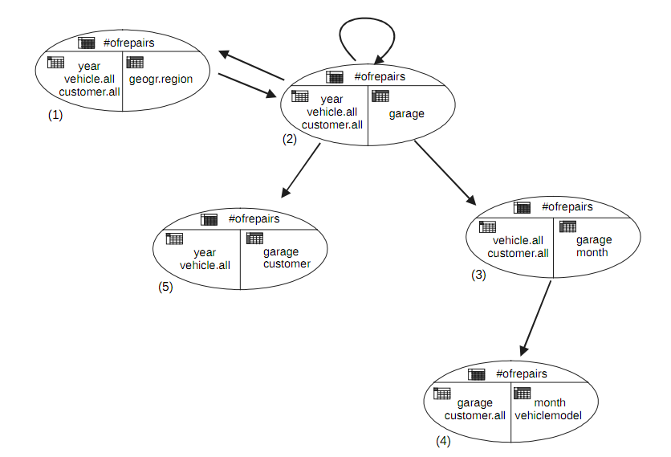
3. Log-based recommendations
Promise [DaWaK 2000]
0.3
0.1
1
0.5
0.1
1
If the current query asks for:
Number of repairs by garage for year 2009 for
all vehicles and all customers
Recommend:
drilldown to month

Slide 82
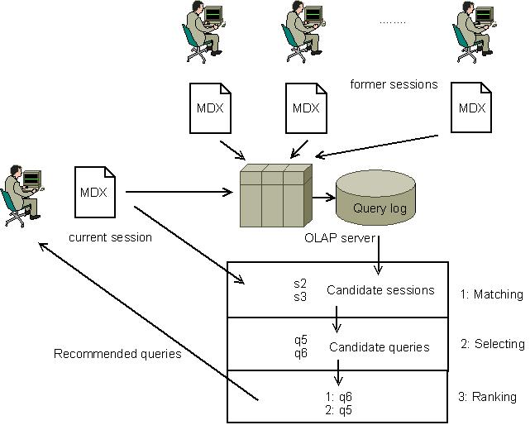
3. Log-based recommendations
[DaWaK 2009]

Slide 83
3. Log-based recommendations
[DaWaK 2009]
Distances proposed
  Between positions in a cube
    Hamming
    Based on the shortest path in the dimension
  Between queries
    Based on dimension-wise differences
    Hausdorff
  Between sessions
    Based on the subsequence
    Edit distance
More distances? See “Similarity measures for multidimensional data” by Baikousi, Rogkakos,
Vassiliadis at ICDE 2011

Slide 84
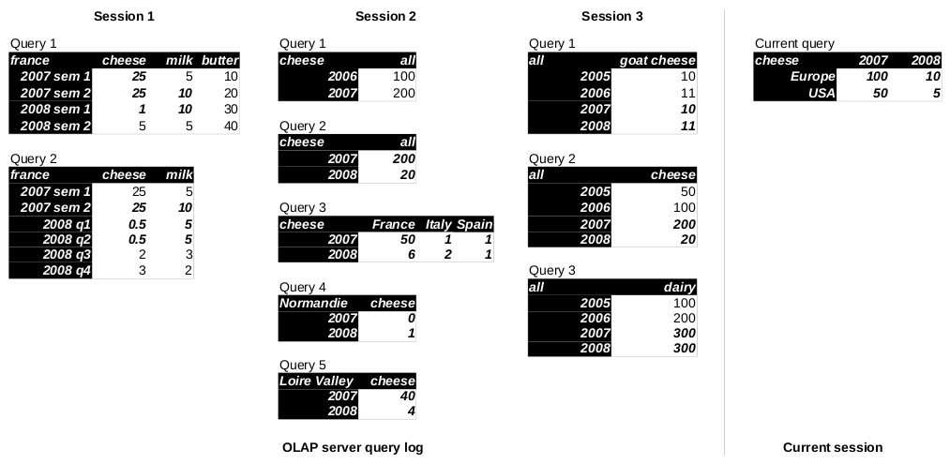
4. Log and expectation-based recommendations [IJDWM 2011]
Hm this looks
strange to me...
Interesting...

Slide 85
4. Log and expectation-based recommendations [IJDWM 2011]
1: detect
difference pairs
5: ... then
exception queries
2: specialize a most
general pair in the log?
3: suggest the most
general queries...
4: ... then
drilldown queries

Slide 86
Conclusion

Slide 87
Conclusion
The best approach?
  Low formulation effort, proactive, not prescriptive, high expressiveness… yet to be proposed!
  Collaborative for naïve user, content-based for advanced user
How about effectiveness?
  Need to categorize database user’s navigational behavior
    A taxonomy exists in the web but not in databases…
  What recommendation in what context?

Slide 88
Open issues
Some open issues
  How to learn preferences?
  Can preferences be revised?
  What about privacy?
  What if transitivity is dropped?
  What if I don’t know what I prefer?
  How to guess the user query intent?
  …

Slide 89
Bibliography

Slide 90
Bibliography
Motivation
  “The data deluge”, The economist (2010)
  H. V. Jagadish, A. Chapman, A. Elkiss, M. Jayapandian, Y. Li, A. Nandi, C. Yu: “Making database systems usable”, SIGMOD (2007)
  N. Khoussainova, M. Balazinska, W. Gatterbauer, Y. Kwon, D. Suciu: “A Case for A Collaborative Query Management System”, CIDR (2009)
Surveys
  G. Koutrika, Y. Ioannidis, « Personalized systems, from an IR and DB perspective », tutorial at ICDE (2005)
  K. Stefanidis, G. Koutrika, E. Pitoura « A Survey on Representation, Composition and Application of Preferences in Database Systems », ACM Transactions on Database Systems, to appear
  G. Adomavicius, A. Tuzhilin: “Toward the Next Generation of Recommender Systems: A Survey of the State-of-the-Art and Possible Extensions”, IEEE Trans. Knowl. Data Eng. (2005)

Slide 91
Bibliography on preferences
In relational databases
  Preference Formulas
    J. Chomicki, « Preference Formulas in Relational Queries », ACM Transactions on Database Systems, 28(4), pp.427-466 (2003)
  Skyline Operator
    S. Börzsönyi, D. Kossmann & K. Stocker, « The Skyline Operator », Proc. of ICDE, pp. 421 – 430 (2001)
  Preference SQL
    W. Kießling, G. Köstler, « Preference SQL - Design, Implementation, Experiences », Proc. of VLDB, pp. 990-1001 (2002)
  Query personalisation
    G. Koutrika, Y. Ioannidis. Personalization of Queries in Database systems. In Proc. Of ICDE (2004)

Slide 92
Bibliography on preferences
In multidimensional databases
  S. Rizzi. « OLAP Preferences: a research agenda ». Proc DOLAP (2007)
  P. Biondi, M. Golfarelli, S. Rizzi. « myOLAP: An Approach to Express and Evaluate OLAP Preferences ». IEEE TKDE, to appear
  L. Bellatreche, A. Giacometti, D. Laurent, P. Marcel, H. Mouloudi « A Personalization Framework for OLAP Queries », Proc. of DOLAP (2005)

Slide 93
Bibliography on recommendation
Existing approaches in relational databases
  YMAL
    Kostas Stefanidis, Marina Drosou, Evaggelia Pitoura, “You May Also Like Results in Relational Databases”, PersDB (2009)
  QueRIE
    Gloria C., M. Eirinaki, N. Polyzotis, “Query Recommendations for Interactive Database Exploration”, SSDBM (2009)
    J. Akbarnejad, G. Chatzopoulou, M. Eirinaki, S. Koshy, S. Mittal, D. On, N. Polyzotis, J. Swarubini Vindhiya Varman, “SQL QueRIE Recommendations”, PVLDB (2010)
  Recommending join queries
    X. Yang, C. M. Procopiuc, D. Srivastava, “Recommending Join Queries via Query Log Analysis”, ICDE (2009)
  SnipSuggest
    N. Khoussainova, Y. Kwon, M. Balazinska, D. Suciu, “SnipSuggest: Context-Aware Autocompletion for SQL”, PVLDB (2010)

Slide 94
Bibliography on recommendation
Existing approaches in multidimensional databases
  Discovery driven analysis
    S. Sarawagi, “Explaining Differences in Multidimensional Aggregates”, VLDB (1999)
    S. Sarawagi, “User-Adaptive Exploration of Multidimensional Data”, VLDB (2000)
    G. Sathe, S. Sarawagi, “Intelligent Rollups in Multidimensional OLAP Data”, VLDB (2001)
  Profile-based
    H. Jerbi, F. Ravat, O. Teste, G. Zurfluh, “Preference-Based Recommendations for OLAP Analysis”, DaWaK (2009)
  History-based
    C. Sapia, “PROMISE: Predicting Query Behavior to Enable Predictive Caching Strategies for OLAP Systems”, DaWaK (2000)
    A. Giacometti, P. Marcel, E. Negre, A. Soulet, “Query recommendations for OLAP discovery driven analysis”, DOLAP (2009)
    Arnaud Giacometti, Patrick Marcel, Elsa Negre, “Recommending Multidimensional Queries” DaWaK (2009)

